Slide 1





EAGLETS
Then vs Now

Slide 2

OUR TEAM
Saravanan
Josephine
Vishal
Venkat
Chandrashekar
Divakar A
Praveen
Vigneshwar
Sarath
Charan
Sivalatha
Radhika
Naveen

Slide 3
INTRODUCTION
Eaglets is completely based out of different parts of India with diverse backgrounds and culture this activity is going to showcase the baby version of the team vs the recent photographs so be ready to guess.

Slide 4
LET'S GET STARTED

Slide 5
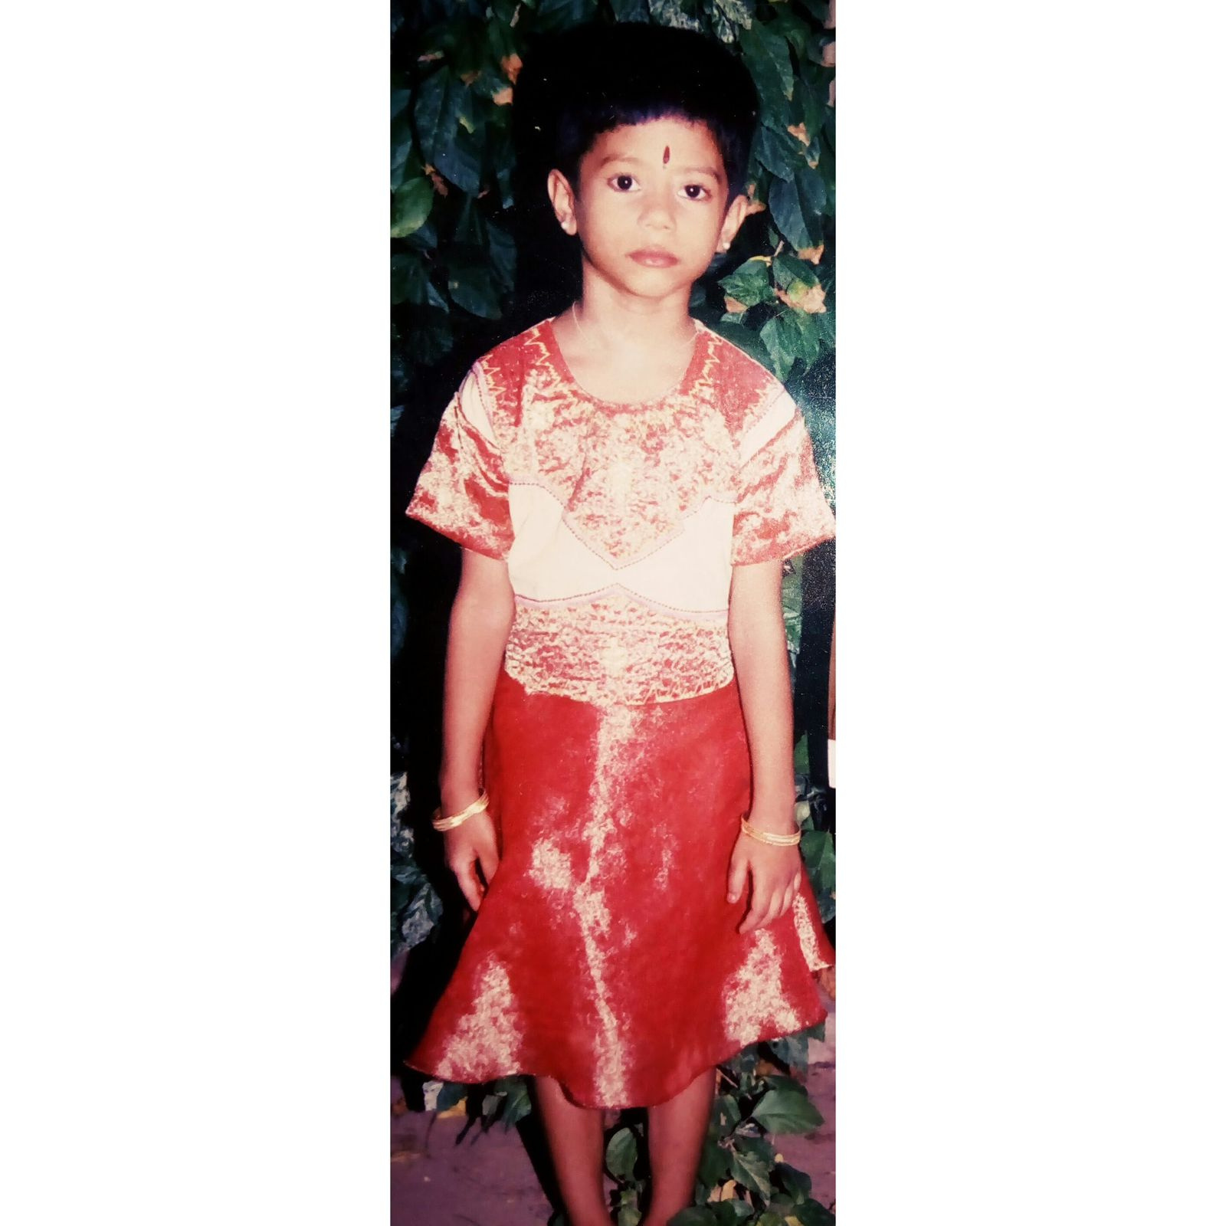

Slide 6
Radhika

Slide 7
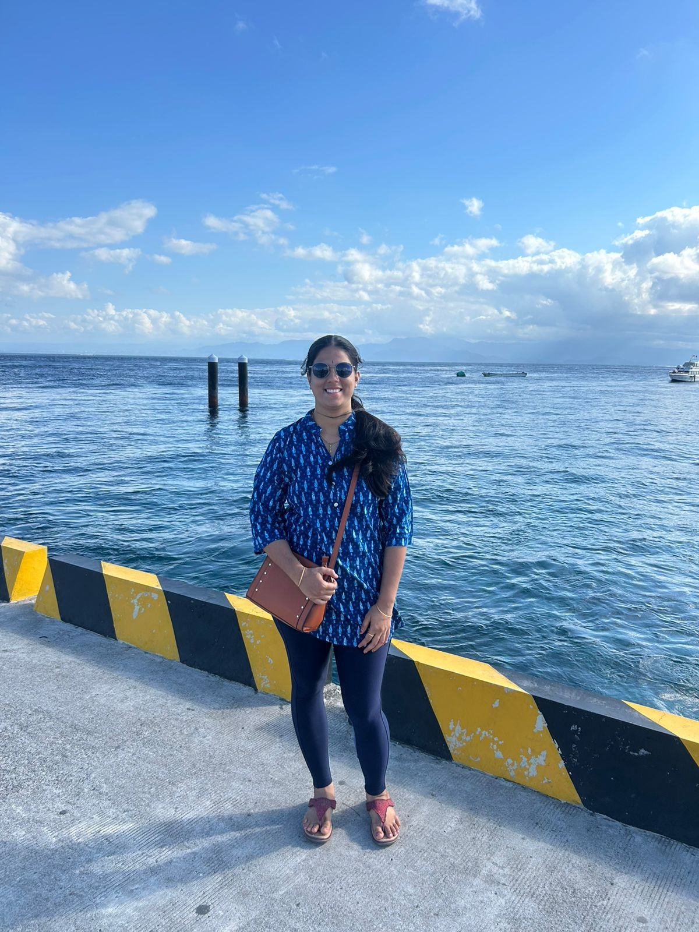

Slide 8
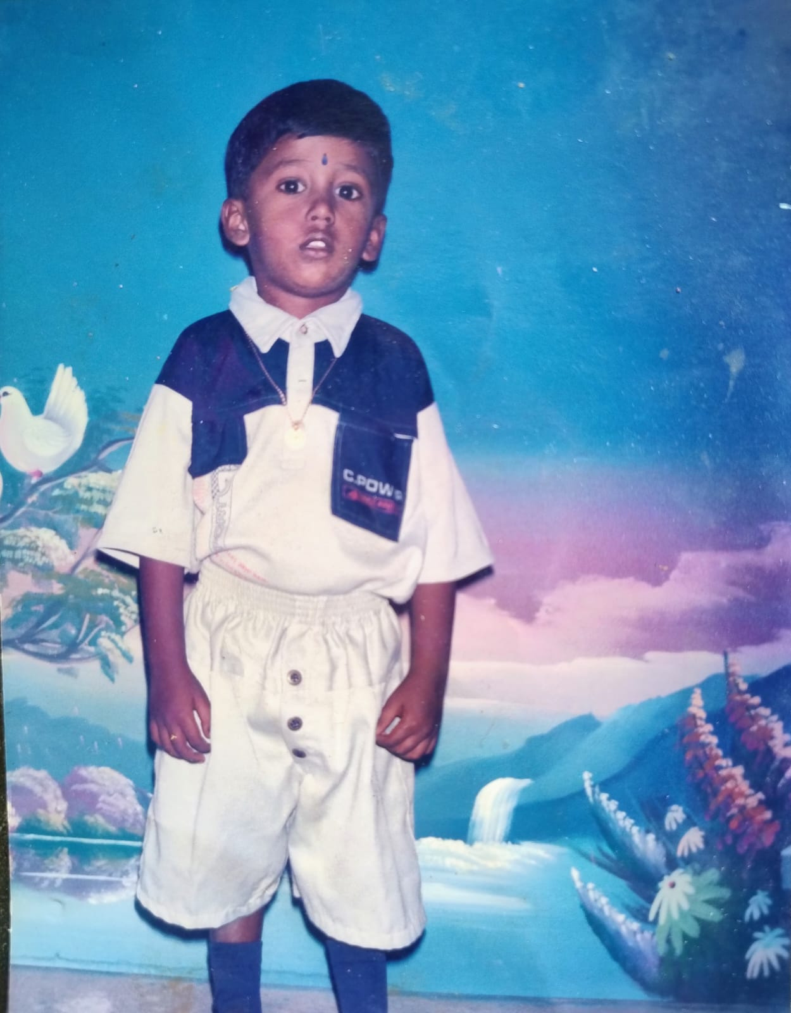

Slide 9
Gokul

Slide 10
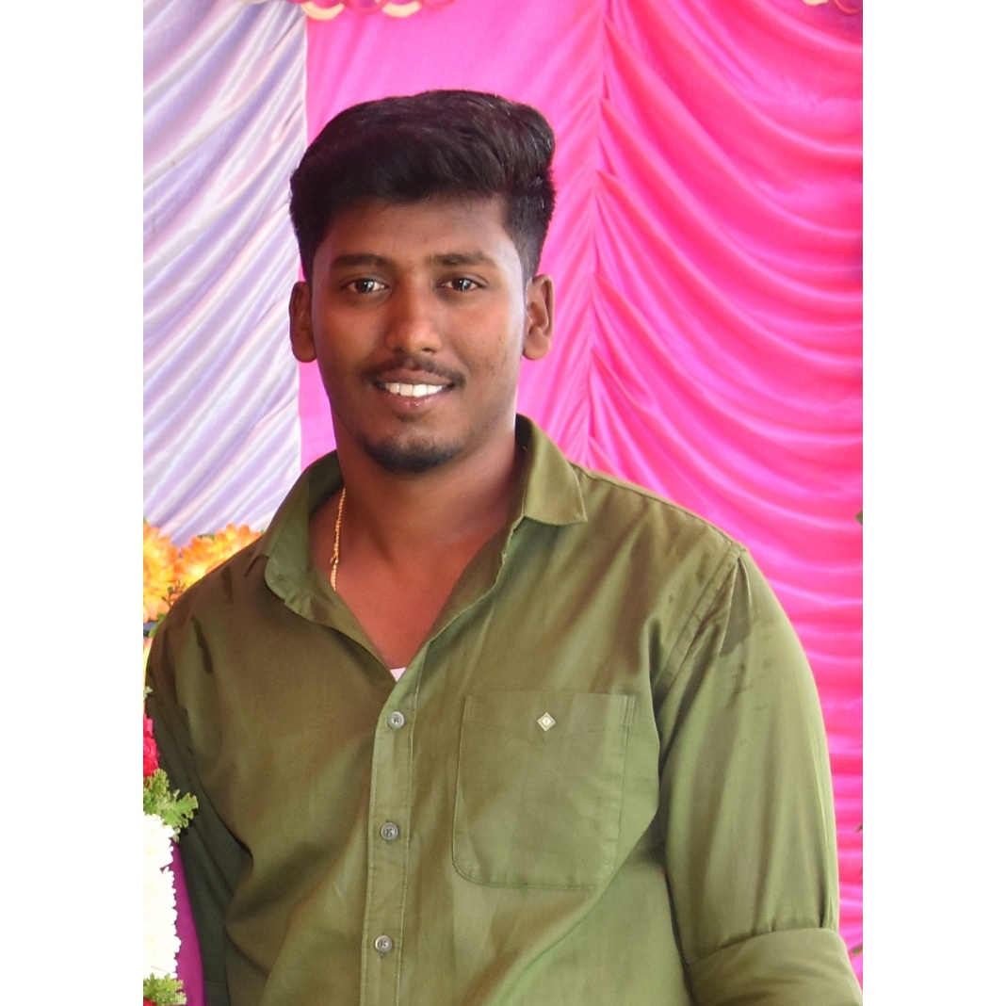

Slide 11
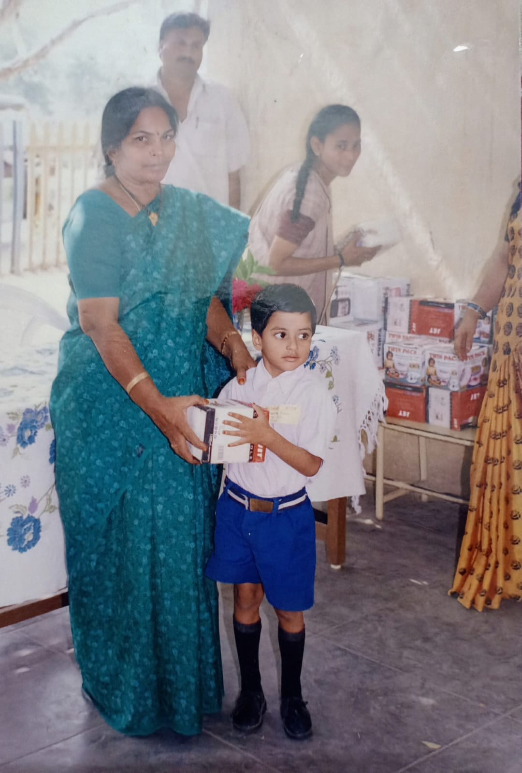

Slide 12
Sarath

Slide 13
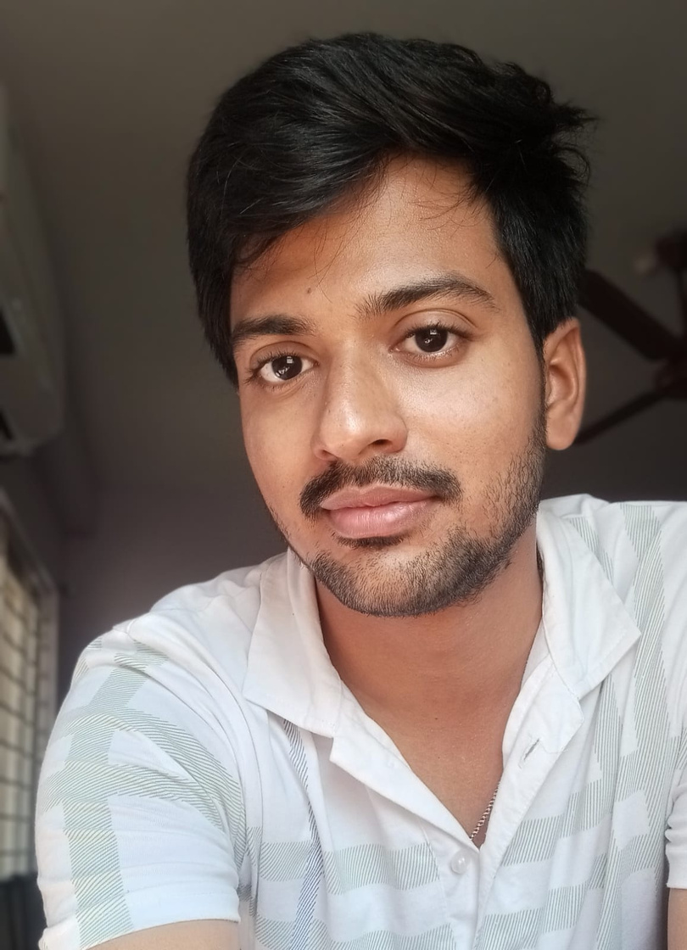
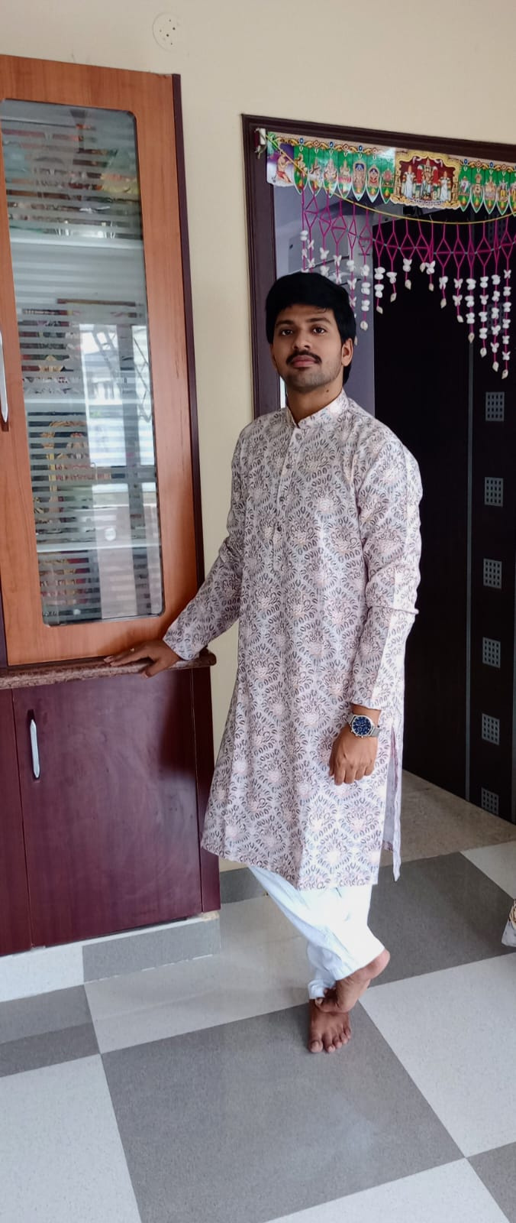

Slide 14
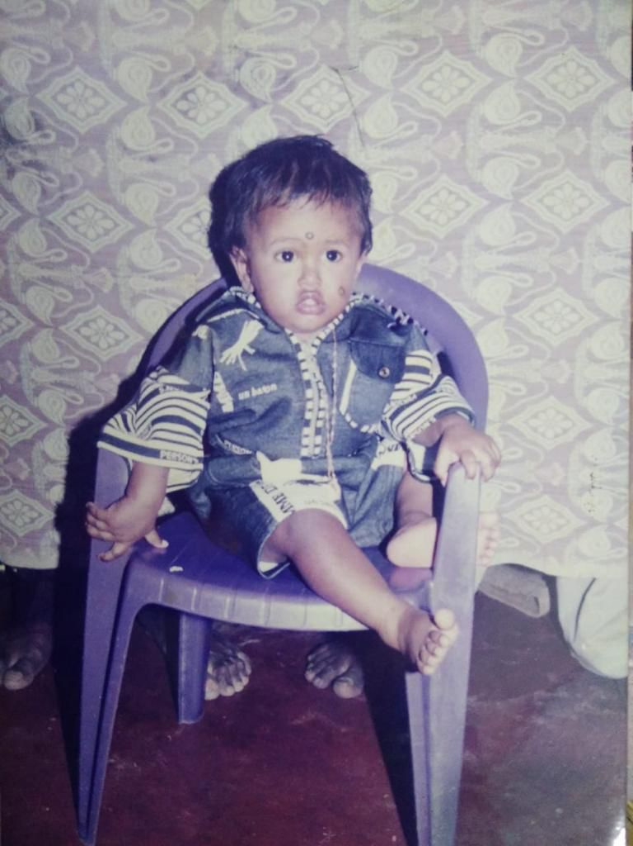

Slide 15
Divakar

Slide 16
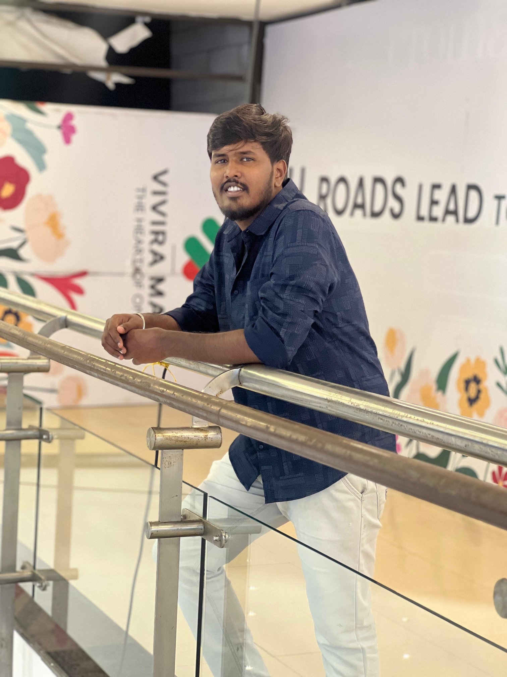

Slide 17
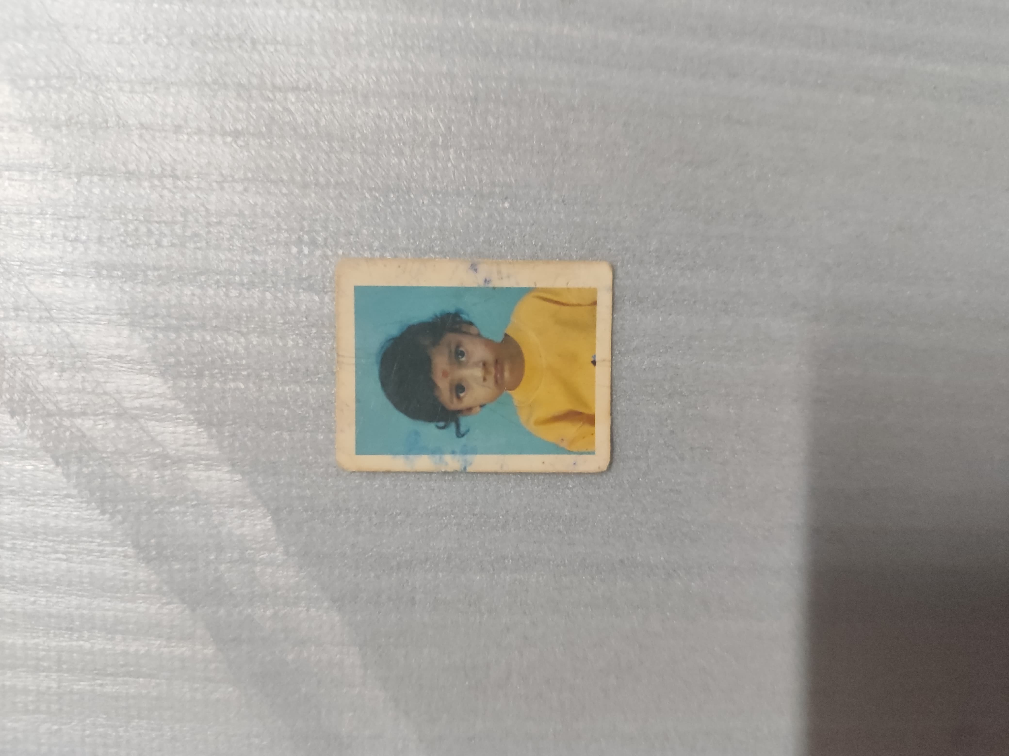

Slide 18
Vasanth

Slide 19
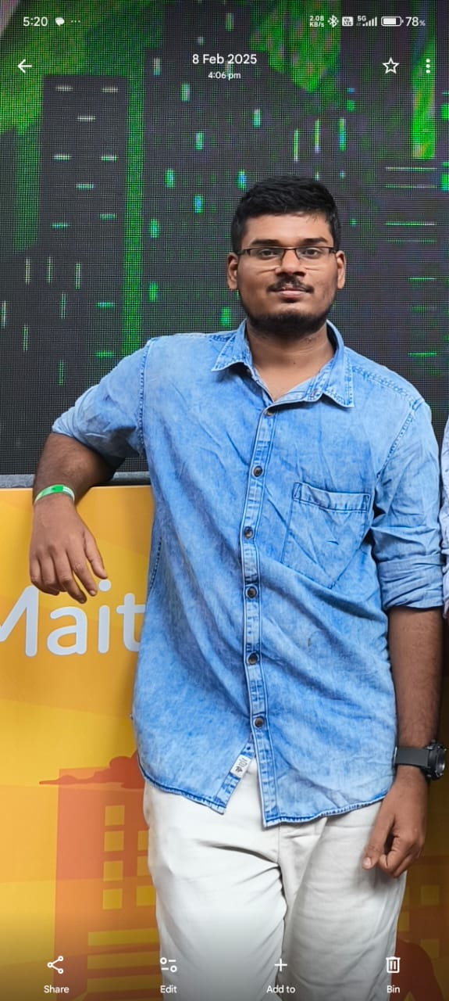

Slide 20
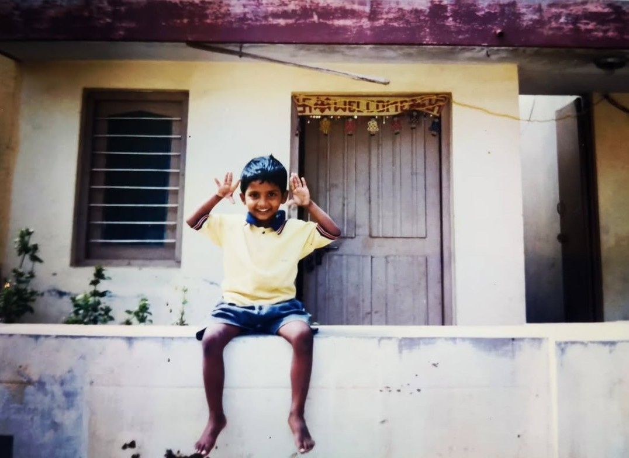

Slide 21
Vishal

Slide 22
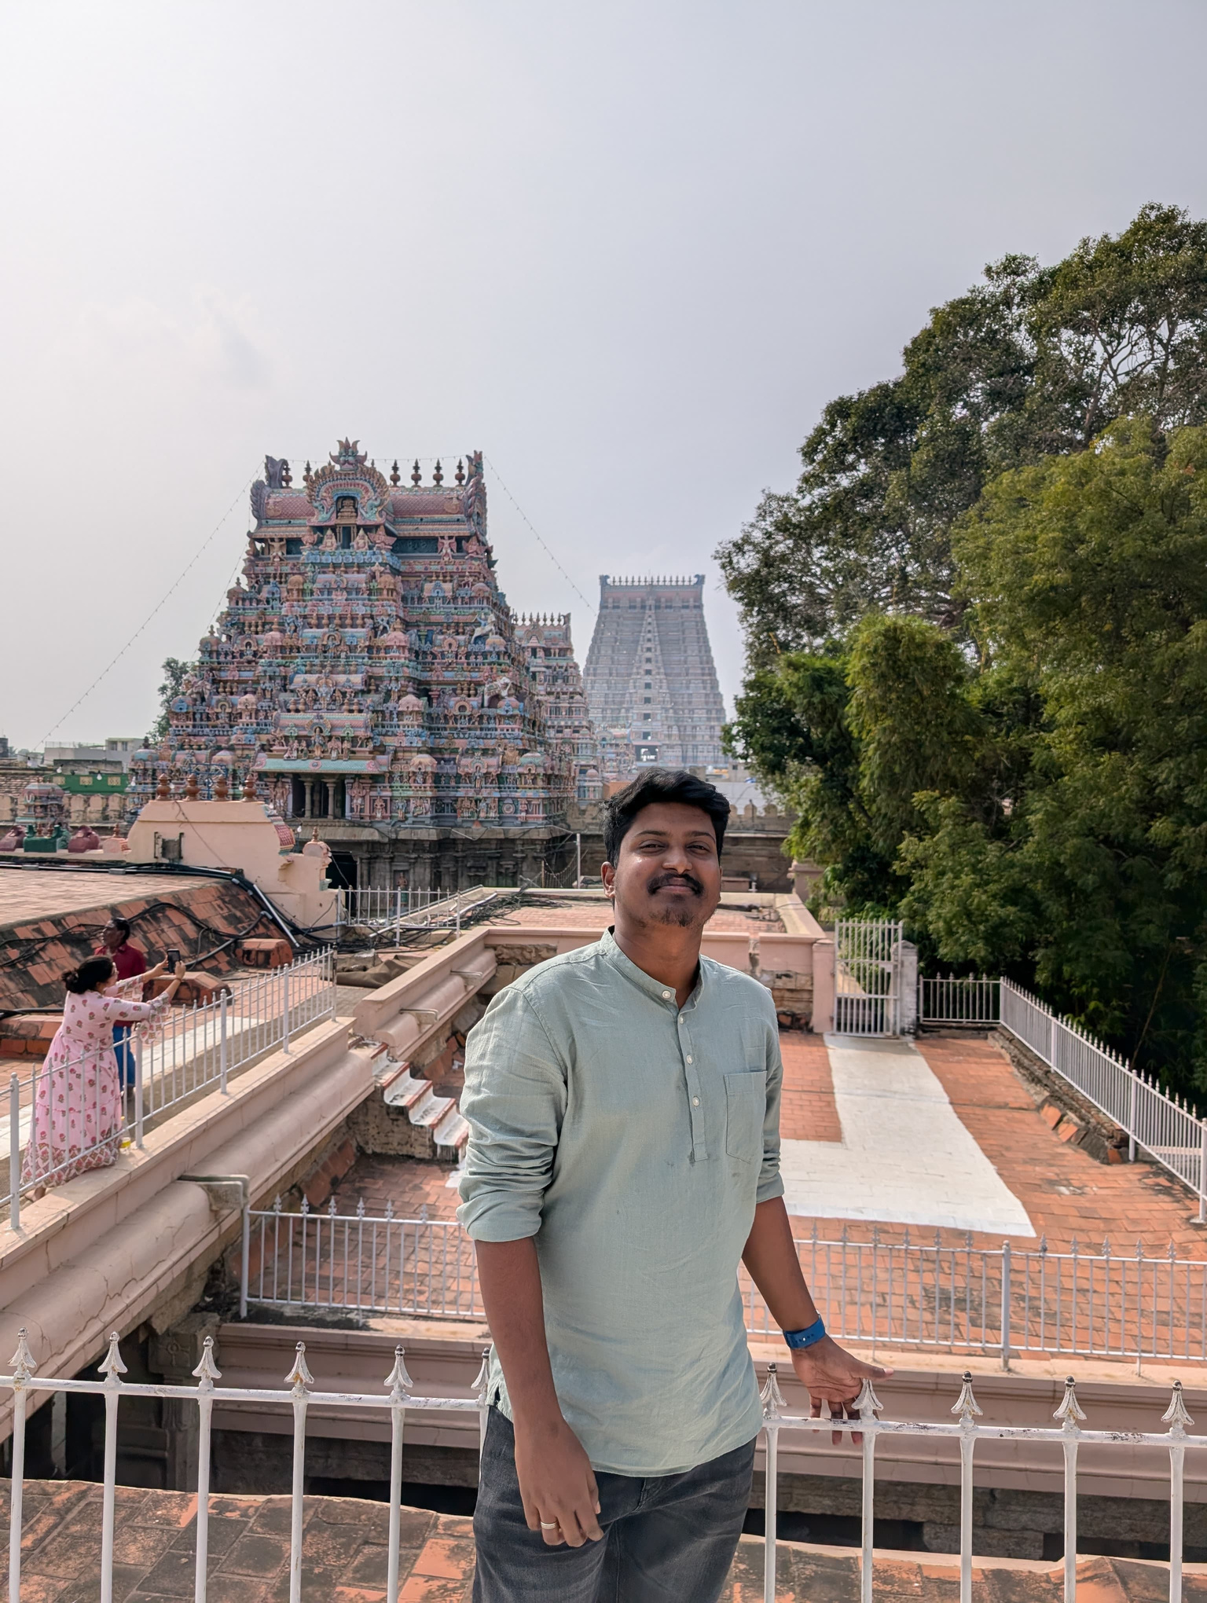

Slide 23
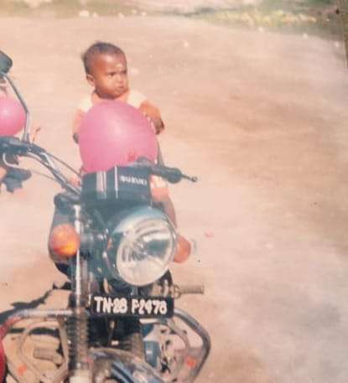

Slide 24
Praveen

Slide 25
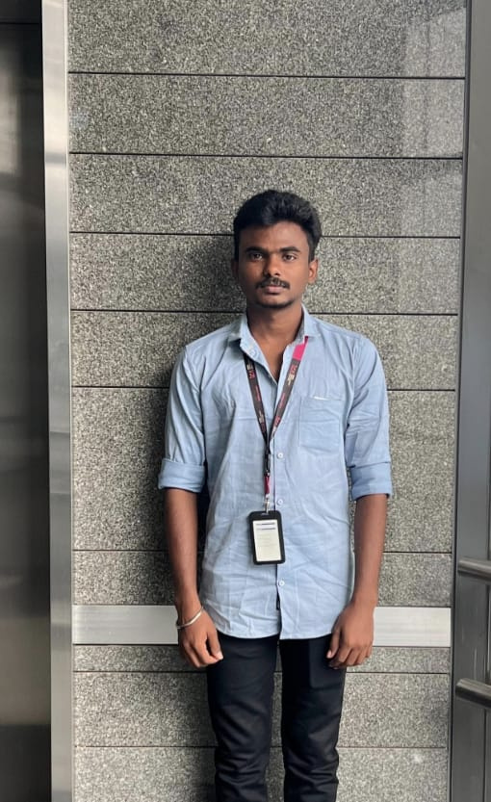

Slide 26
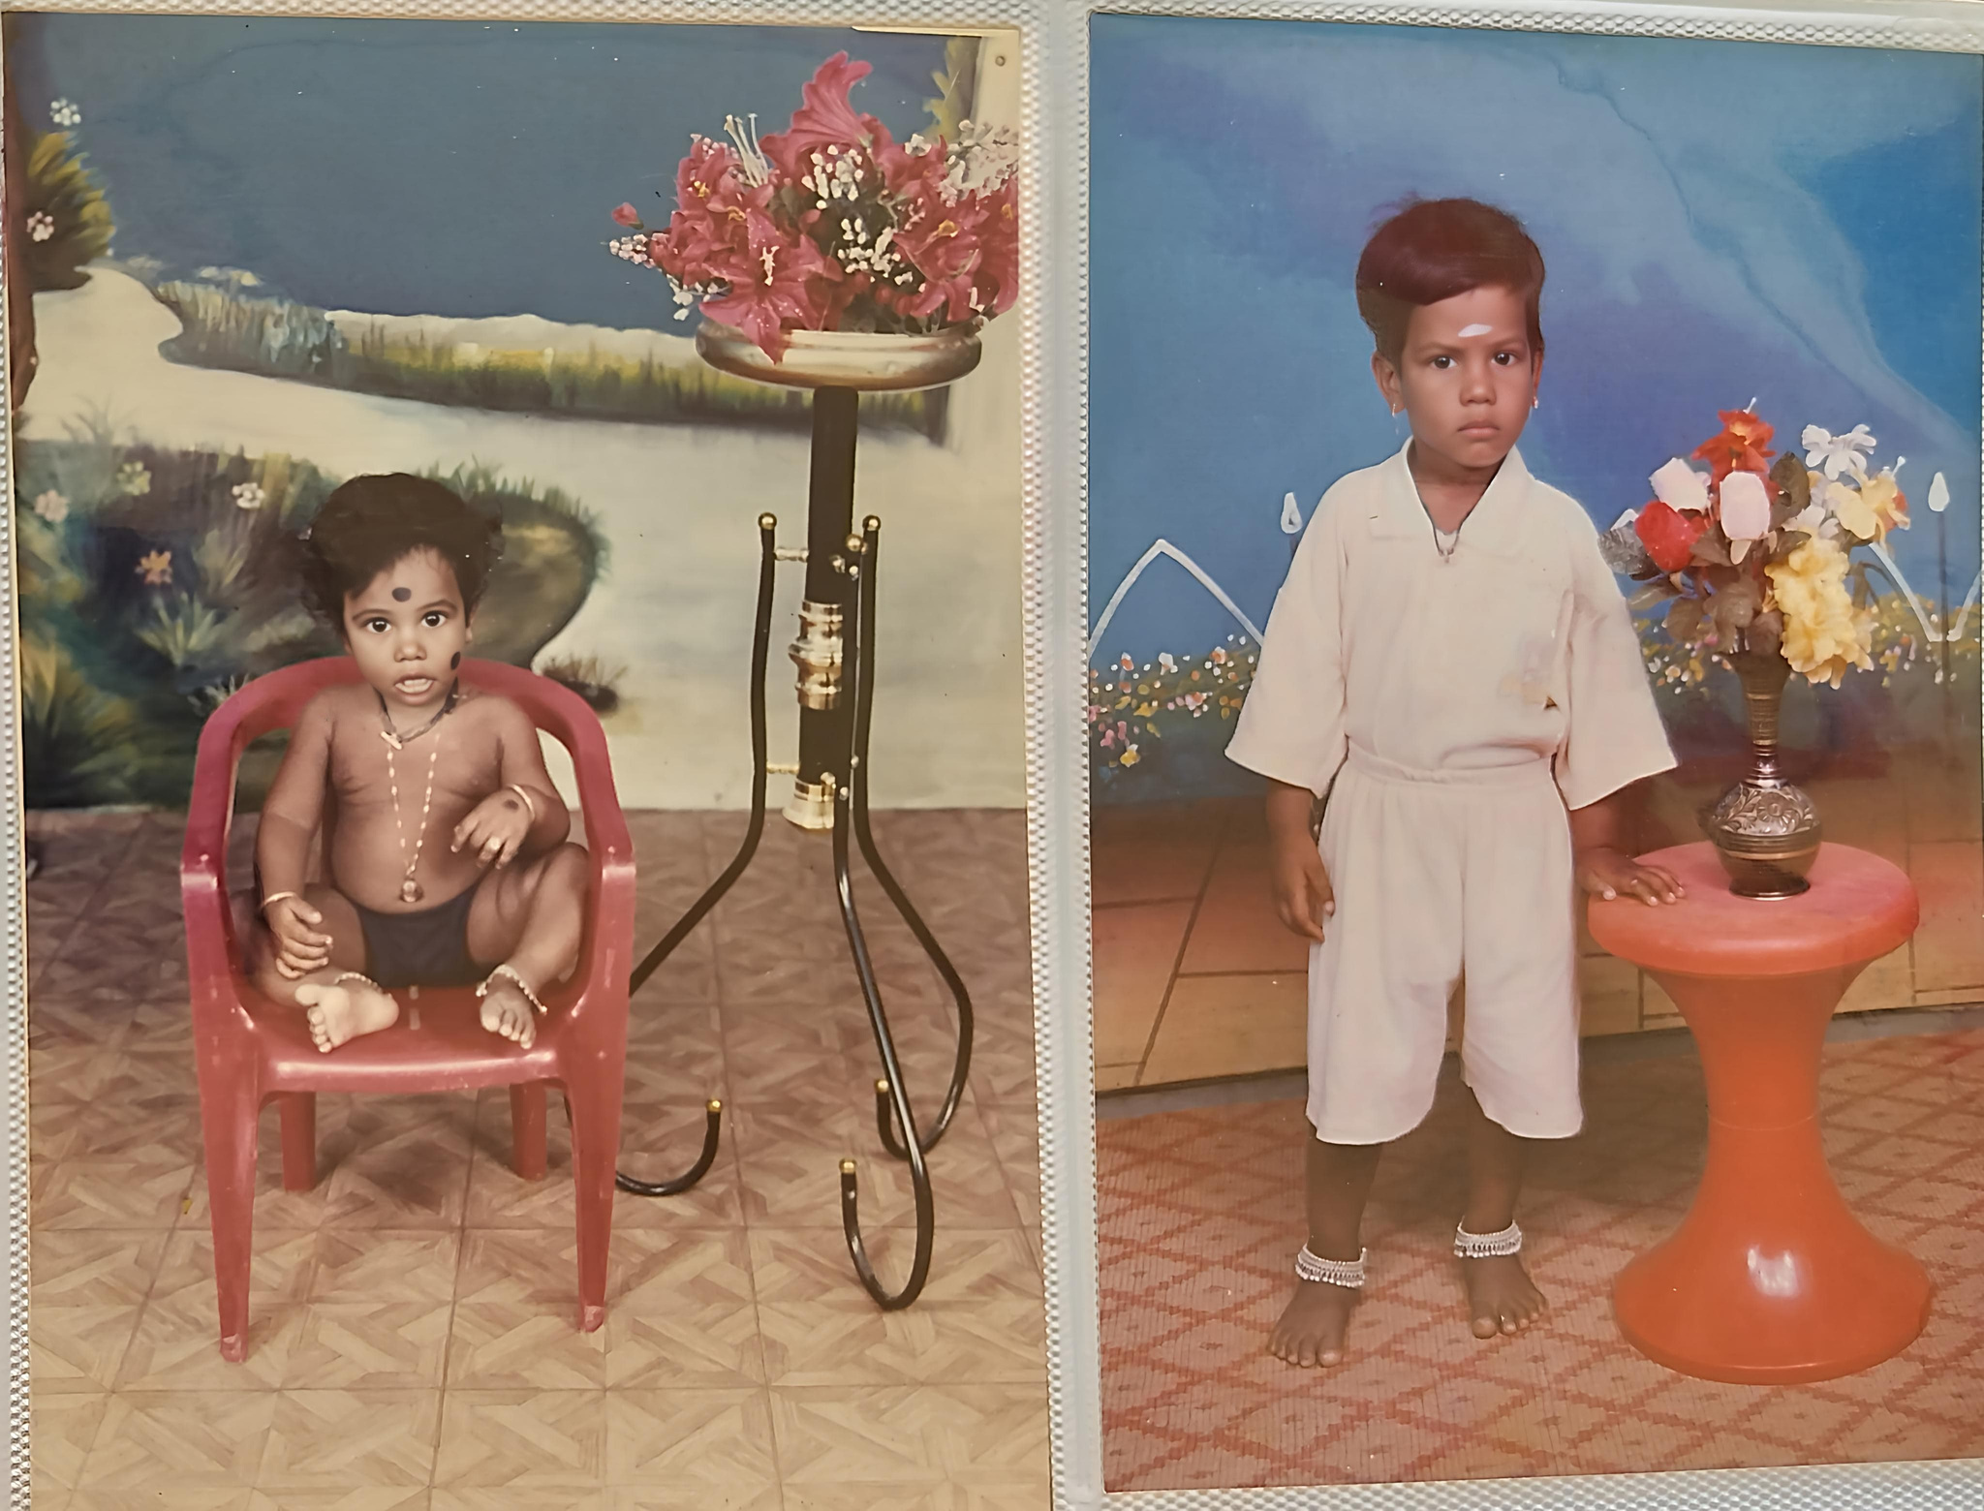

Slide 27
Venkat

Slide 28
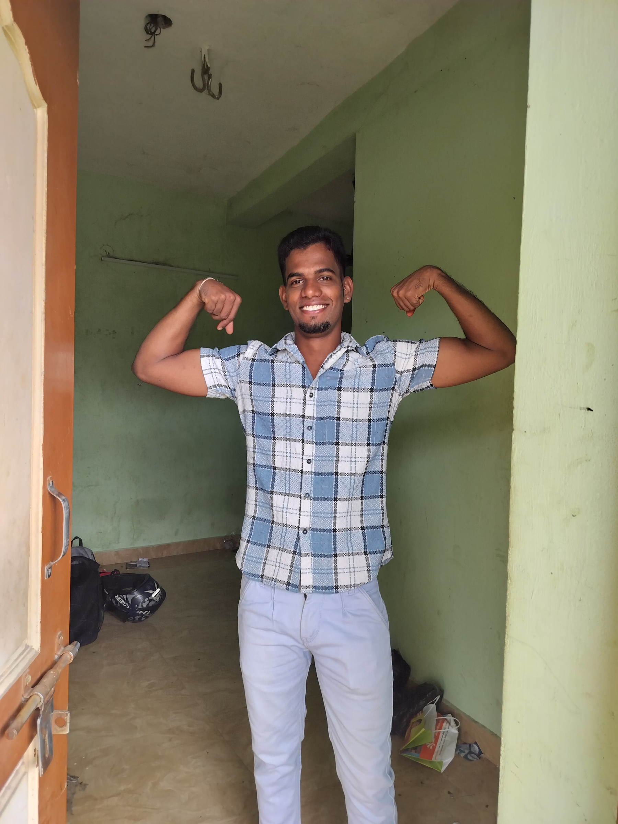

Slide 29
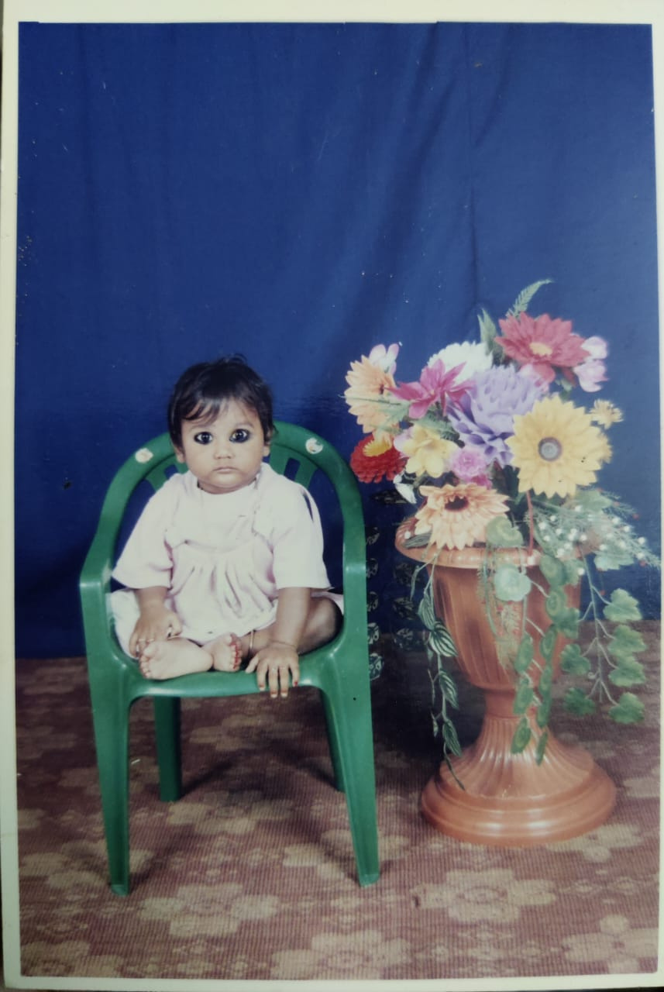

Slide 30
Naveen

Slide 31
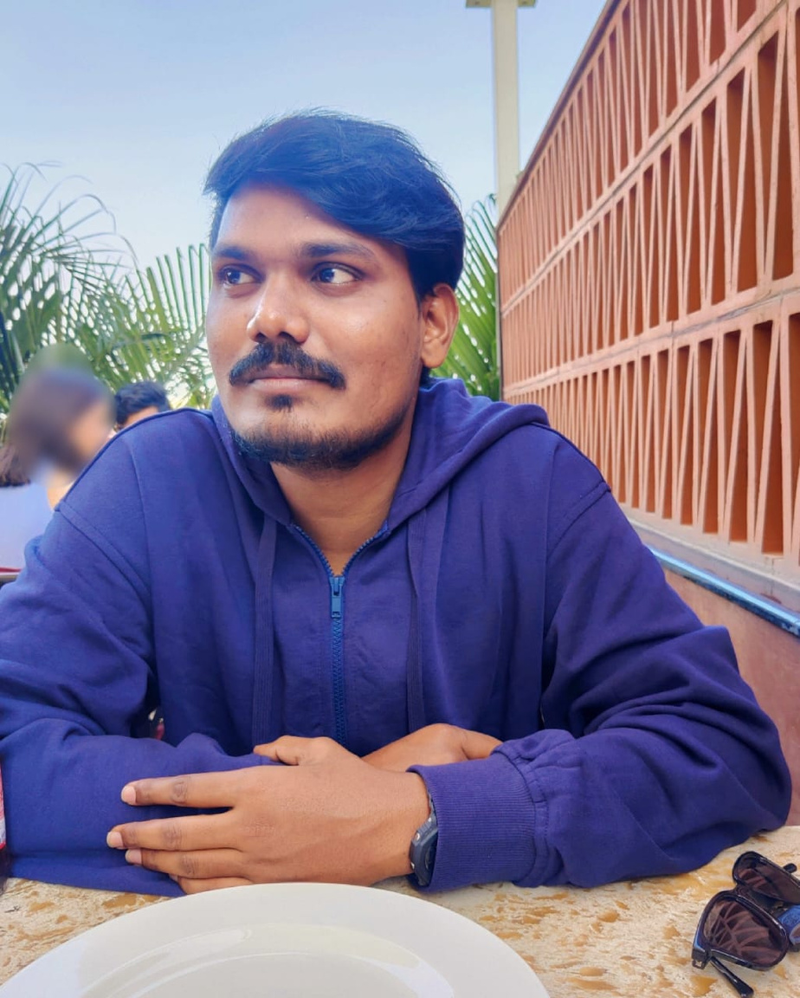

Slide 32
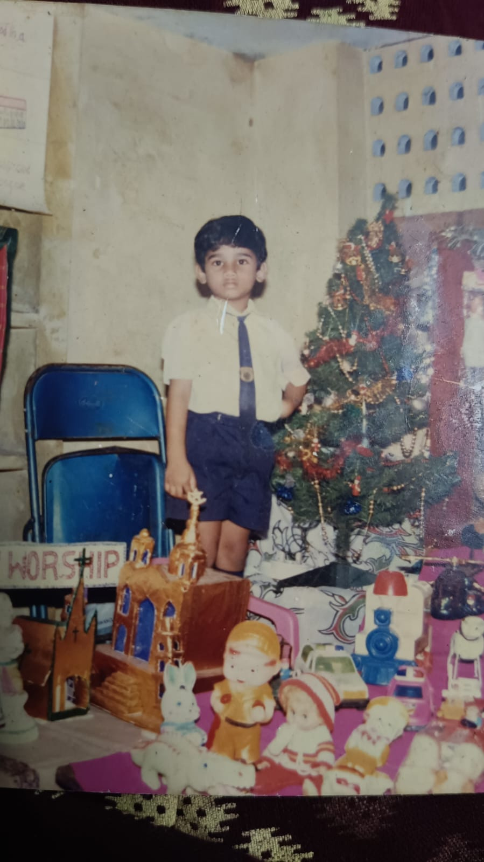

Slide 33
Vigneshwar

Slide 34
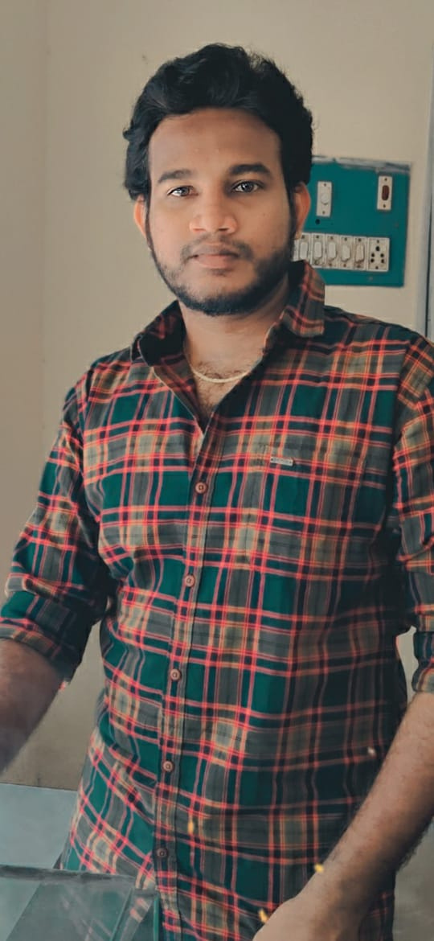

Slide 35
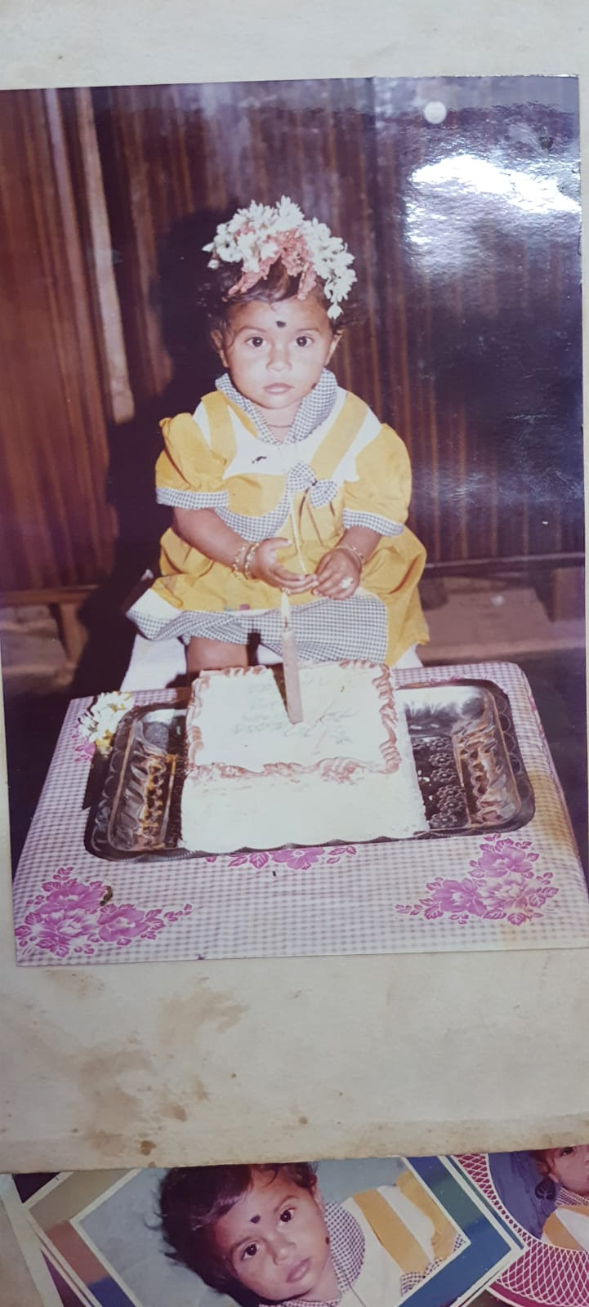

Slide 36
Josephine

Slide 37
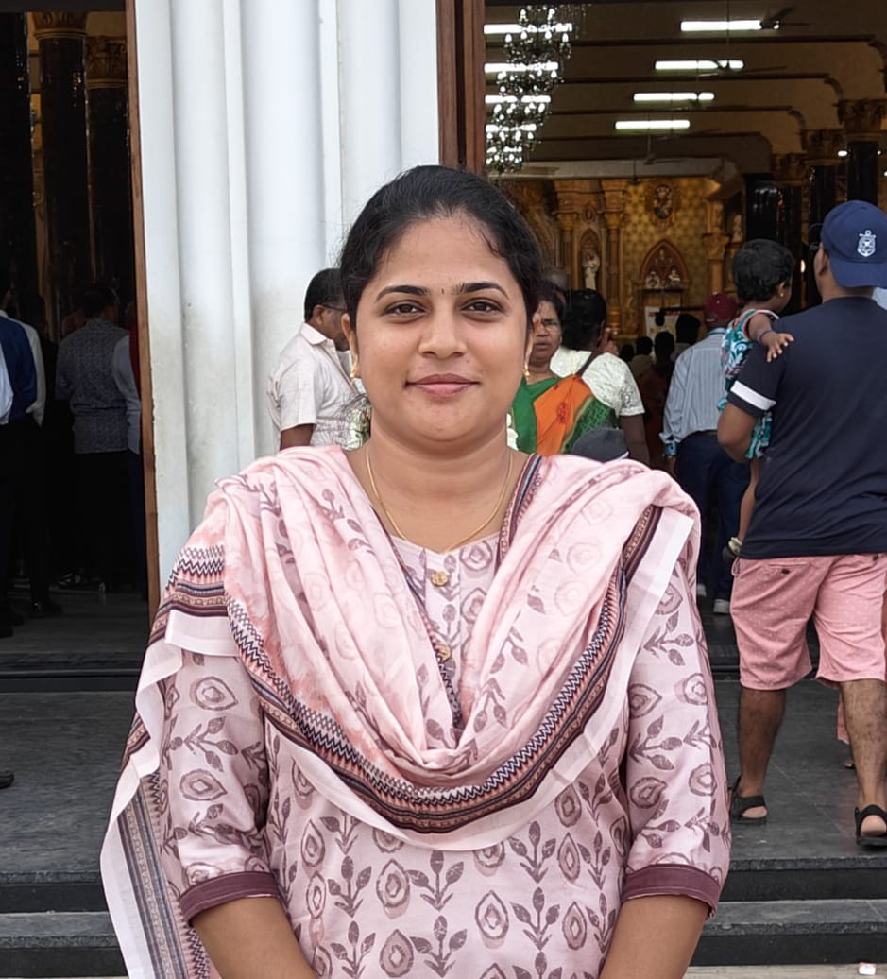

Slide 38
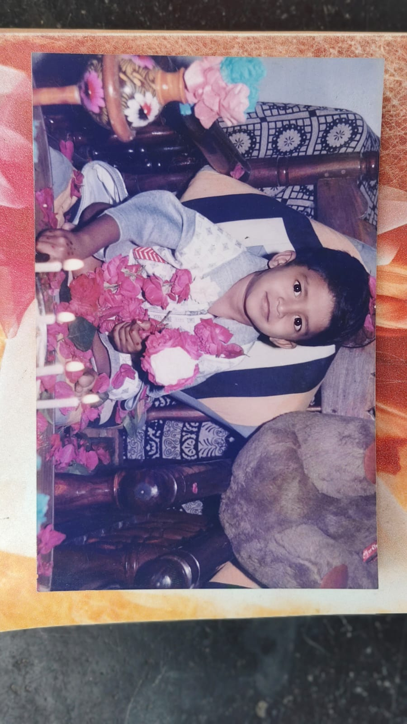

Slide 39
Chandrashekhar

Slide 40
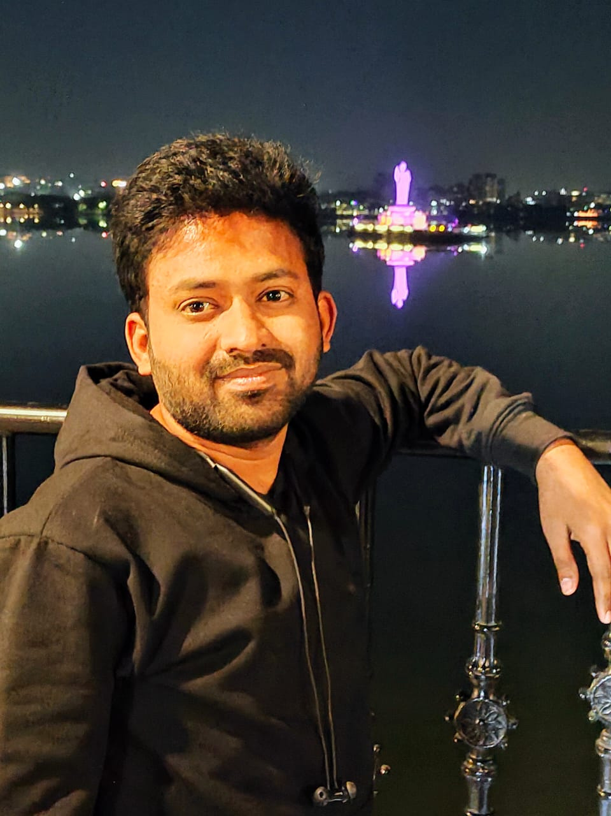

Slide 41
THANK
YOU

